Slide 1
Machine Learning

Slide 2
Course contents
Machine Learning and Pattern Recognition
Supervised Learning
Unsupervised Learning
Reinforcement Learning
Decision process
Feature selection
Pattern recognition process

Slide 3
Books
Text Book
Duda, Richard O., Peter E. Hart, and David G. Stork. Pattern classification. John Wiley & Sons, 2012.
Bishop, Christopher M. Pattern recognition and machine learning. springer, 2006.
Webb, Andrew R. Statistical pattern recognition. John Wiley & Sons, 2003.

Slide 4
What is Machine Learning:
“Machine learning is the field of study that enables a machine to automatically learn from data, improve performance from experiences, and predict things without being explicitly programmed.” (Arthur Samuel 1959)

Slide 5
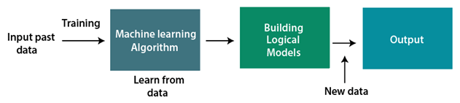
How does Machine Learning work
A Machine Learning system learns from historical data which in known as training data, builds the prediction models, and whenever it receives new data, predicts the output for it.
The accuracy of predicted output depends upon the amount of data, as the huge amount of data helps to build a better model which predicts the output more accurately.

Slide 6
Features of Machine Learning
Machine learning uses data to detect various patterns in a given dataset.
It can learn from past data and improve automatically.
It is a data-driven technology.
Machine learning is much similar to data mining as it also deals with the huge amount of the data.

Slide 7
Why Machine Learning
Human has limitation in assessing the huge amount of data, manually.
Using ML, algorithms can be trained on the huge amount of data that can:
explore the data
construct the models
predict the required output automatically.
can save both time and money.
Decision making in various sector including finance
Finding hidden patterns and extracting useful information from data.
Notes:
Currently, machine learning is used in self-driving cars, cyber fraud detection, face recognition, and friend suggestion by Facebook, etc. Various top companies such as Netflix and Amazon have build machine learning models that are using a vast amount of data to analyze the user interest and recommend product accordingly.

Slide 8
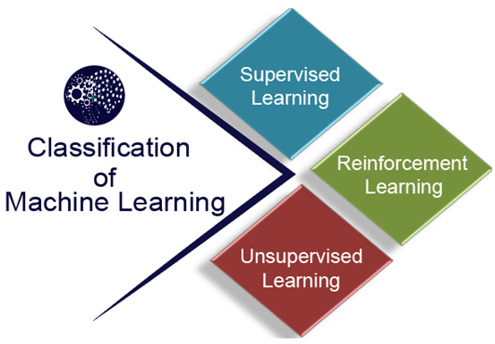
Classification of Machine Learning
At a broad level, machine learning can be classified into three types:
Supervised learning
Unsupervised learning
Reinforcement learning

Slide 9
Supervised Learning
A type of machine learning method in which:
labeled data is provided to the machine learning system in order to train it,
The system creates a model using labeled data to understand the datasets and learn about each data,
On the basis of learning, Model predicts the output for an unlabeled data
Basically discovers patterns in the data that relate data attributes with a target (class) attribute.
Performance of model is measured on the basis of that how accurately new data is predicted

Slide 10
Supervised Learning
The two most common types of supervised learning are
Classification
Prediction/Classification of the discrete values
outputs are discrete labels
Male or Female, True or False, Spam or Not Spam, etc.
Regression
algorithms are used to predict the continuous values
outputs are real-valued.
price, salary, age, stock exchange market prediction
Notes:
classification is about predicting a label and regression is about predicting a quantity.
Classification: Will it be Cold or Hot tomorrow? Regression: What is the temperature going to be tomorrow?

Slide 11
Unsupervised Learning
In unsupervised learning or clustering there is no explicit supervision, and the system forms clusters or “natural groupings” of the input patterns.
The data have no target attribute. i.e. input data set is unlabeled
we don't have a predetermined result. The machine tries to find useful insights from the huge amount of data

Slide 12
Unsupervised Learning
The two most important examples are
Dimension reduction
Principle component Analysis(PCA)
Singular Value Decomposition(SVD), for matrix factorization in PCA
Independent computing analysis (ICA)
a technique to separate the mixture of signals into their different sources
Clustering.
K- MEANS
density-based clustering
unsupervised learning methods that identify distinctive groups/clusters in the data
Hierarchical Clustering

Slide 13
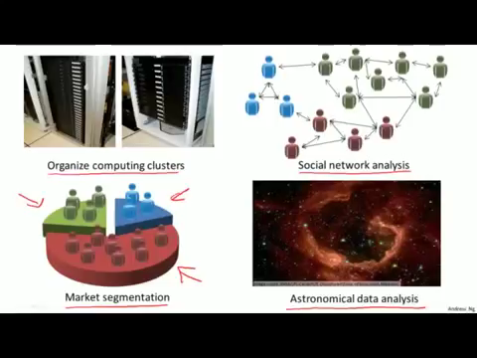
Unsupervised Learning

Slide 14
Reinforcement Learning
Reinforcement Learning is a type of Machine Learning, and thereby also a branch of Artificial Intelligence.
A feedback-based learning method, in which a learning agent gets a reward for each right action and gets a penalty for each wrong action
The agent learns automatically with these feedbacks and improves its performance to get the most reward points.

Slide 15
SOME OTHE TYPES OF ML
Semi-supervised learning
In which only a subset of the training data is labeled.
Time-series forecasting
Such as in financial markets
Anomaly detection
Such as used for fault-detection in factories and in surveillance

Slide 16
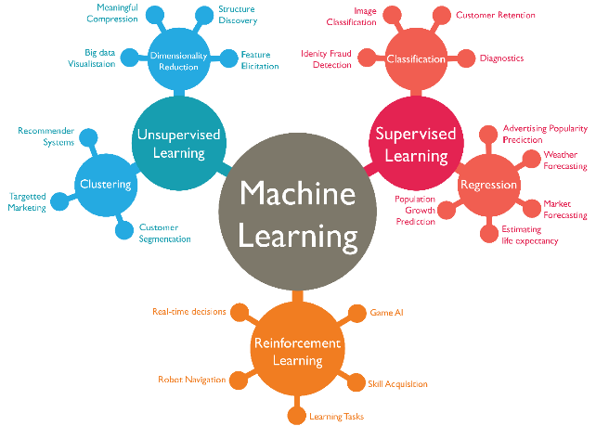

Slide 17
Applications of ML
Face Recognition
Character recognition
Finger print recognition
Object recognition
Medical imaging
Document classification
And many more…

Slide 18
pattern recognition
Pattern recognition is the use of machine learning algorithms to identify patterns.
It classifies data based on statistical information or knowledge gained from patterns and their representation.
In case of labelled data, labeled training data is used to train pattern recognition systems. A label is attached to a specific input value that is used to produce a pattern-based output.
In the absence of labeled data, computer algorithms may be employed to find unknown patterns.
Notes:
https://www.section.io/engineering-education/understanding-pattern-recognition-in-machine-learning/
https://dzone.com/articles/machine-learning-and-pattern-recognition

Slide 19
Features of pattern recognition
Pattern recognition has the following features:
completely rely on data and derives any outcome or model from data itself
It has great precision in recognizing patterns.
It can recognize unfamiliar objects.
It can recognize shapes and objects accurately from various angles.
It can recover patterns in instances of missing data.
A pattern recognition system can discover patterns that are partly hidden.

Slide 20
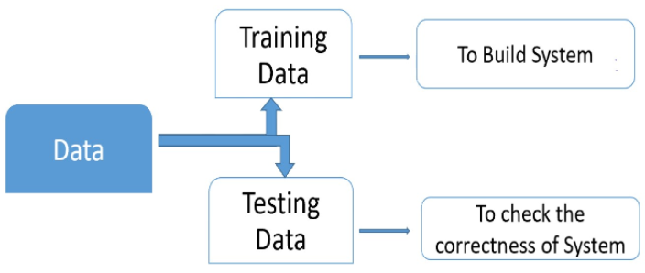
How pattern recognition works
A system gets trained and becomes adaptable to give result in an accurate manner
A section of the dataset is used for training the system while the rest is used for testing it.

Slide 21
Training Data
The training set contains images or data used for training or building the model.
Training rules are used to provide the criteria for output decisions.
All the relevant information is extracted from the data and results are obtained.
Generally, 80-85% of the data of the dataset is taken for training data.
Testing Data
Testing data is used to test the system.
It is the set of data which is used to verify whether the system is producing the correct output after being trained or not.
Generally, 20% of the data of the dataset is used for testing.
Testing data is used to measure the accuracy of the system.

Slide 22
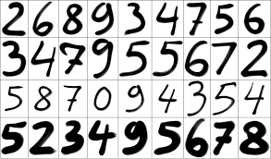
Example
Notes:
Character recognition

Slide 23
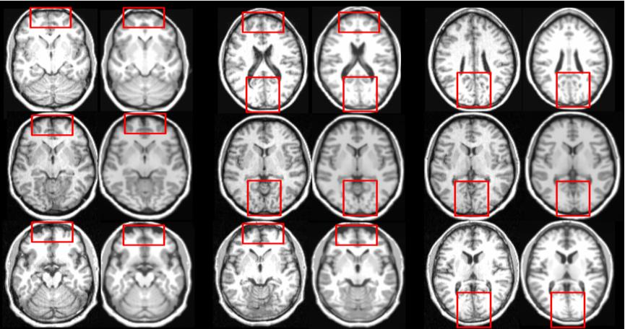
Example
Notes:
Medical imaging

Slide 24
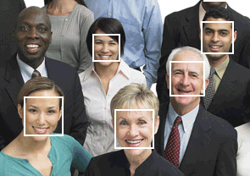
Segmentation
Notes:
technique of splitting customers into separate groups depending on their attributes or behavior,

Slide 25
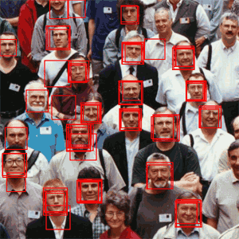
Notes:
Face Recognition

Slide 26
Machine Perception
Build a machine that can recognize patterns:
Speech recognition
Fingerprint identification
OCR (Optical Character Recognition)
DNA sequence identification

Slide 27
An Example
“Sorting incoming Fish on a conveyor according to species using optical sensing”
Sea bass
Species
Salmon
Notes:
Sea bass: lengthy, wider, more lightness (Golden colored)

Slide 28
Problem Analysis
Set up a camera and take some sample images to extract features
Length
Lightness
Width
Number and shape of fins
Position of the mouth, etc…
This is the set of all suggested features to explore for use in our classifier!

Slide 29
Preprocessing and Features Extraction
Use a segmentation operation to isolate fishes from one another and from the background
Information from a single fish is sent to a feature extractor whose purpose is to reduce the data by measuring certain features
The features are passed to a classifier.

Slide 30
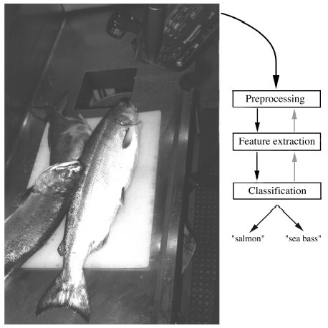

Slide 31
Classification
Select the length of the fish as a possible feature for discrimination

Slide 32
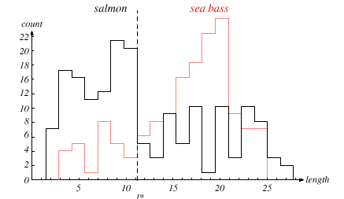

Slide 33
The length is a poor feature alone!
Select the lightness as a possible feature.

Slide 34
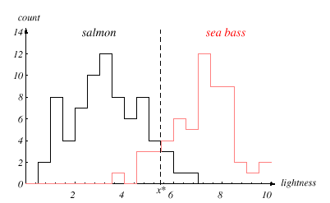

Slide 35
Threshold decision boundary and cost relationship
Move our decision boundary toward smaller values of lightness in order to minimize the cost (reduce the number of sea bass that are classified salmon!)
Task of decision theory
Notes:
Salmon is tasty than see bass. So if salmon goes with see bass, customer will be happy, otherwise complain. So reduce the number of sea bass that are classified salmon!

Slide 36
Adopt the lightness and add the width of the fish
Fish x^{T} = [x₁, x₂]
Lightness
Width

Slide 37
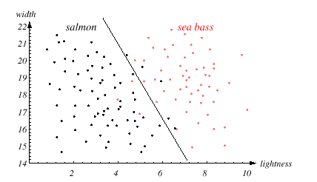
Rule for separating the fish

Slide 38
Add more feature?
Some features might be redundant.
Those features which don’t improve accuracy significantly but increase computational cost (CC).
Add color of fish eye?
Correlation
Computational cost
Due to correlation between features CC increases. So use features with least correlation
Might we ever have too many features?
possibly even degrade the performance

Slide 39
We might add other features that are not correlated with the ones we already have. A precaution should be taken not to reduce the performance by adding such“noisy features”
Ideally, the best decision boundary should be the one which provides an optimal performance such as in the following figure:
Notes:
Noise: some exceptional data w.r.t some sequence/pattern. Called gray area.

Slide 40
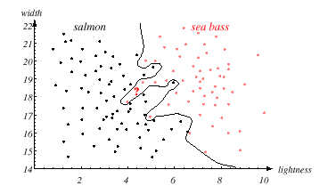

Slide 41
However, our satisfaction is premature because the central aim of designing a classifier is to correctly classify novel input
Issue of generalization!

Slide 42
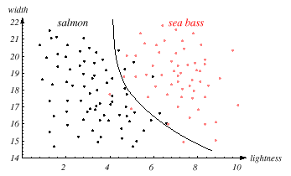

Slide 43
Our decisions are fundamentally task or cost specific.
We wish to favor a small number of features, which might lead to simpler decision regions, and a classifier easier to train
Robust
Noise
Notes:
Classifier must be robust with least noise. Robust(Efficient and effective(accurate))

Slide 44
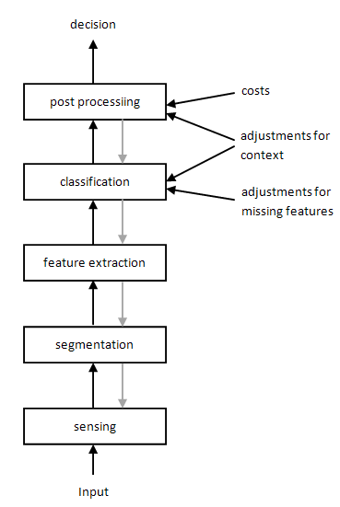
PR process : main phases

Slide 45
PR process : main phases
Sensing: In this phase, the pattern recognition system converts the input data into analogous data.
Segmentation: This phase ensures that the sensed objects are isolated.
Feature extraction: This phase computes the features or properties of the objects and sends them for further classification.
Classification: In this phase, the sensed objects are categorized or placed in groups or cases.
Post-processing: Here, further considerations are made before a decision is made.
Notes:
The post-processor uses the output of the classifier to decide on the recommended action.
https://www.section.io/engineering-education/understanding-pattern-recognition-in-machine-learning/

Slide 46
System Performance
Error rate(Prob. of misclassification)
Speed
Cost
Robustness
Reject option
Return on investment

Slide 47
Reading Assignment
Chapter one, Duda

Slide 48
THE END

